Slide 1



The mean value of a function
Learning Objectives
To be able to find the mean value of a function and apply transformations.
To be able to apply a range of integration techniques including by substitution and by parts.
Starter Questions

Slide 2
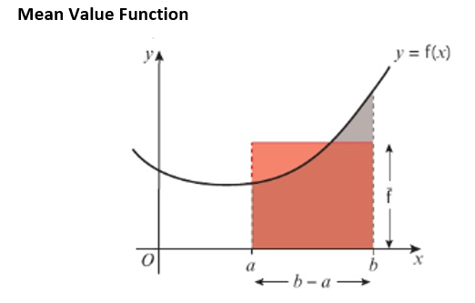

Slide 3
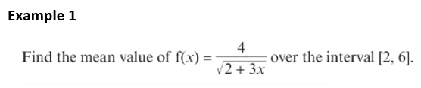

Slide 4
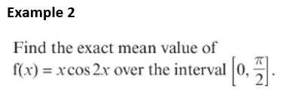

Slide 5


Slide 6
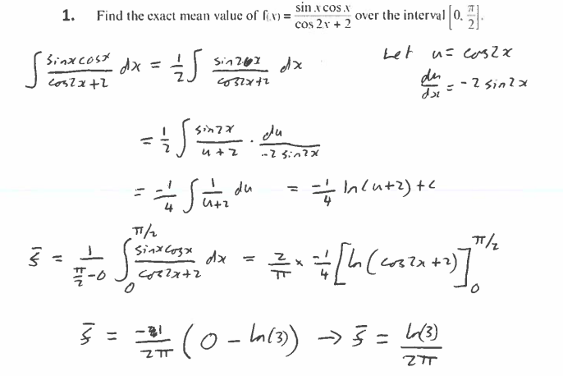
Answers

Slide 7
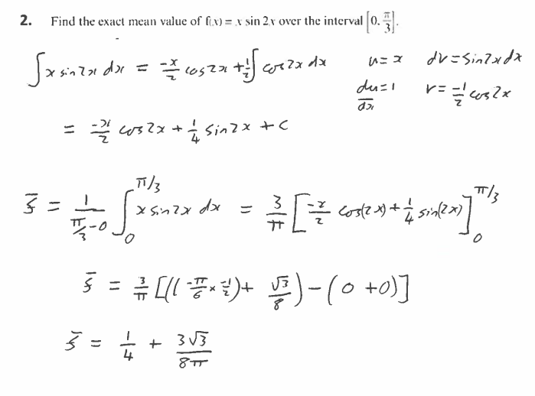

Slide 8


Slide 9
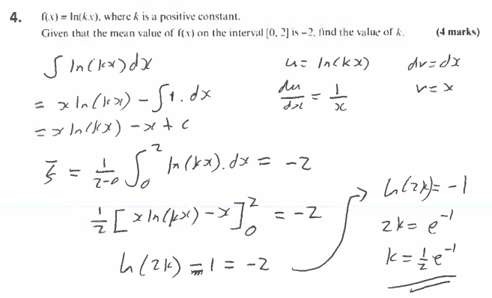

Slide 10
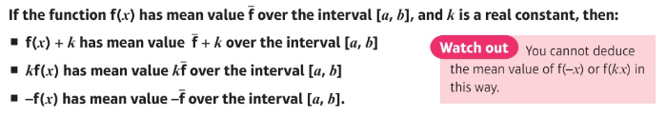
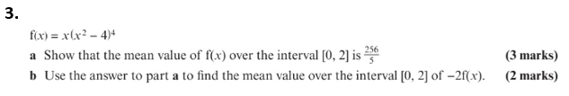
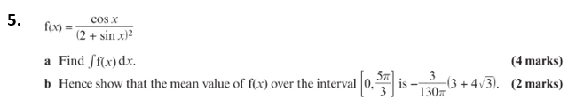

Slide 11
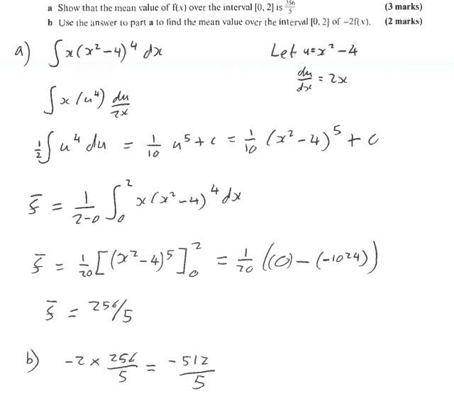
Answers

Slide 12
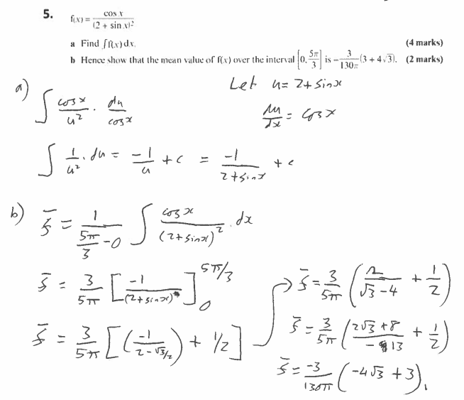

Slide 13
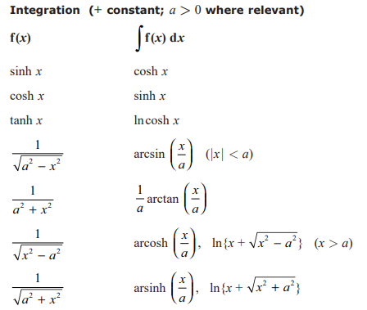
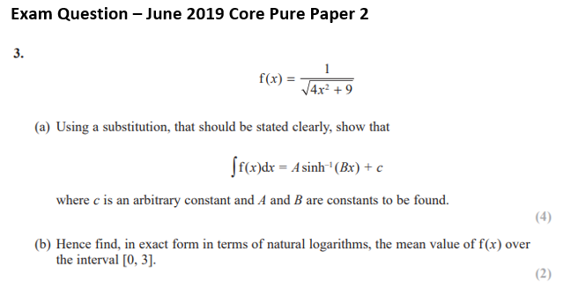

Slide 14
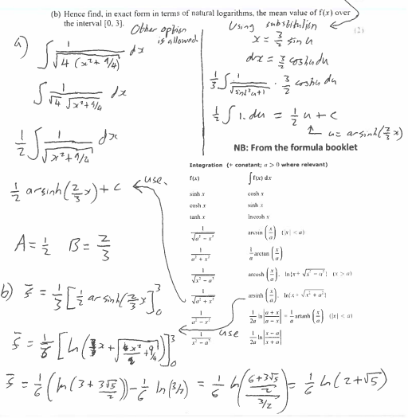
Answers

Slide 15
The mean value of a function
Learning Objectives
To be able to find the mean value of a function and apply transformations.
To be able to apply a range of integration techniques including by substitution and by parts.
Reflection
Before this lesson I could…
During this lesson I learnt that…
I now need to…

Slide 16
